Slide 1
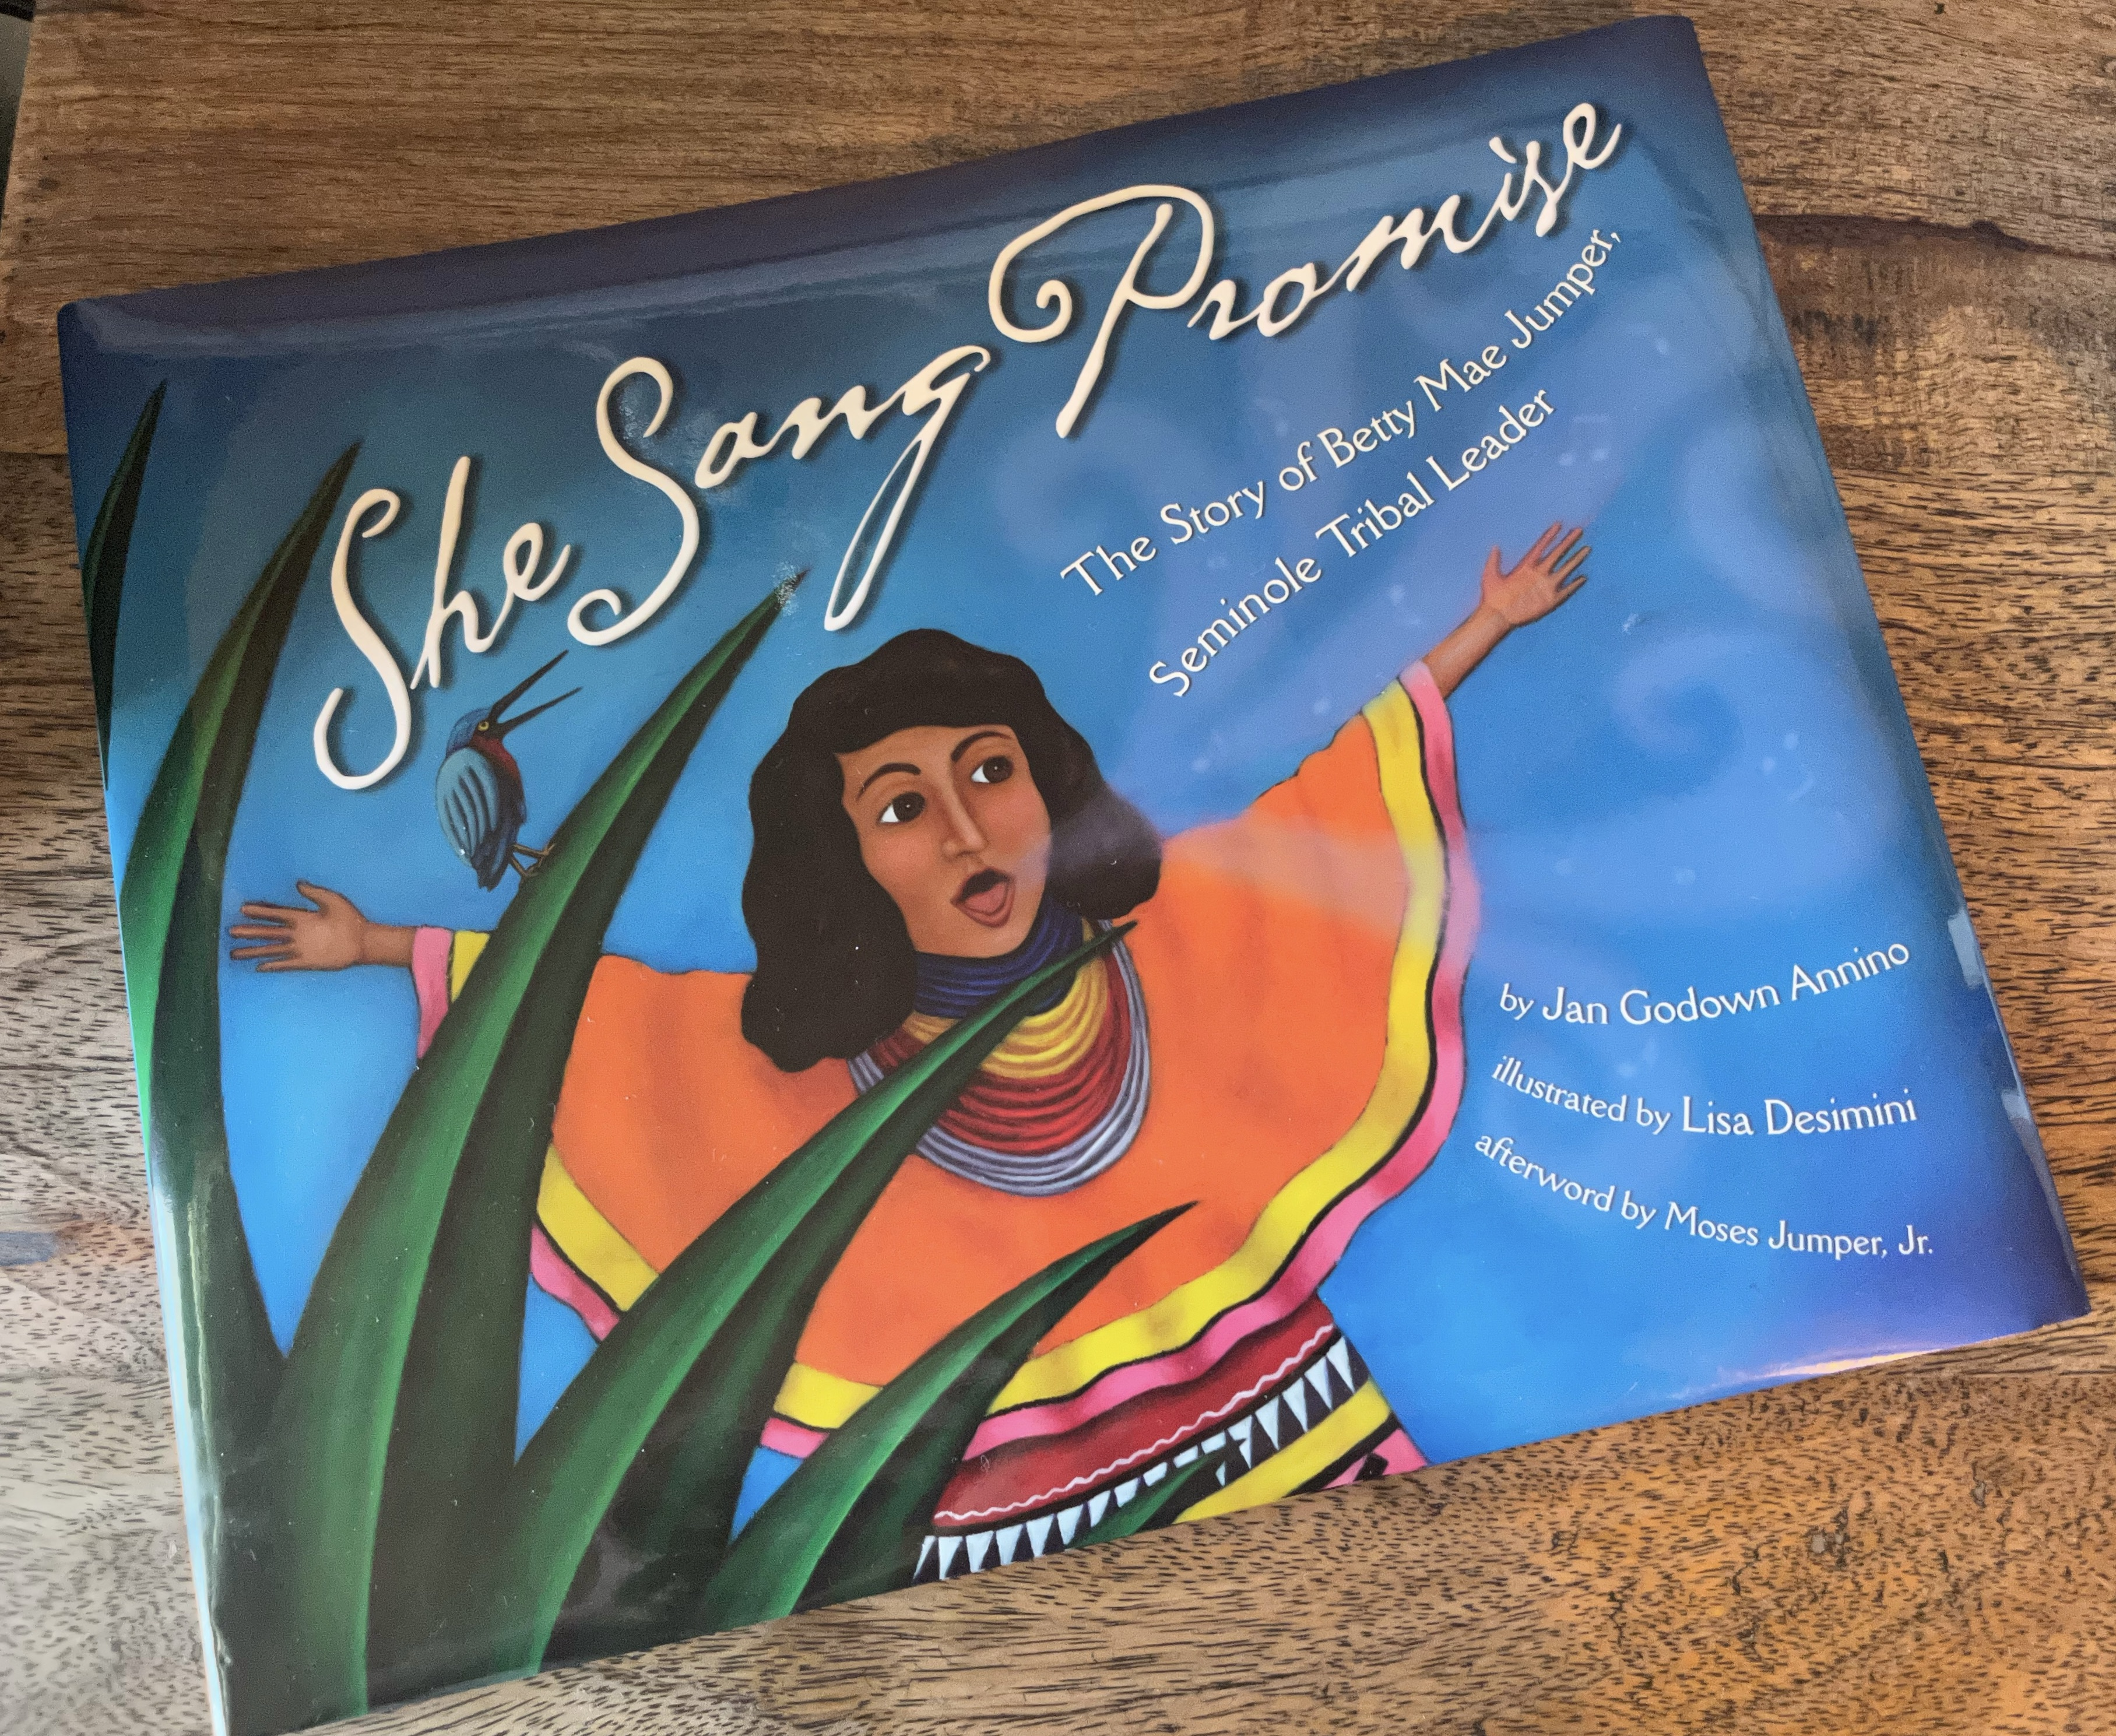
She Sang Promise: The Story of Betty Mae Jumper, Seminole Tribal Leader by Jan Godown Annino illustrated by Lisa Desimini afterword by Moses Jumper Jr.

Slide 2
Discussion Questions
Why did Betty Mae and her family move to the Dania Reservation?
Why does Betty Mae not want to learn to use a gun or skin a rabbit?
Why is school so important to Betty Mae? Where does she go to school?
Name some of the roles that Betty Mae played in her community.
Why are the Elder’s stories so important to Betty Mae and the Seminole people?
What kind of foods are found in a Seminole garden? Have you ever eaten any? Which ones?
What three languages does Betty Mae speak? Why is it so important?

Slide 3
Activity Ideas!
Select a plant of animal from Betty Mae’s story. Research it and talk about it with your friends and family.
Go through the Glossary in the back of She Sang Promise. Can you identify the plants and animals in the glossery in the art of the book?
Draw something that inspired you from Betty Mae’s story. What do you imagine her Seminole family camp looked like? Can you draw it? What does a chickee look like?
Visit the Ah-Tah-Thi-Ki Seminole Museum on Big Cypress! Wander through the cypress dome, visit the Village and hunting camp, and learn more about the Seminole culture and history. July is Teacher Appreciation Month! Teachers and their guests can visit the Ah-Tah-Thi-Ki Museum for FREE the month of July. RSVP at https://www.ahtahthiki.com/teachers/

Slide 4
